Slide 1
Leveraging Digital Technologies
Lina Jichi, Manager of Health Financing Advisory and Monitoring,
Department of Health - Abu Dhabi (DOH)

Slide 2
Why did Abu Dhabi pushed digital technology in Healthcare?
In 2005, Abu Dhabi defined a vision to deliver “world-class” quality healthcare which pushed healthcare providers to improve . . .
Increased Demand
Mandating Health insurance
Well Informed Population
Increased competition among providers
Compliance with more regulations
Higher Expectation
Several factors pushed the facilities to improve

Slide 3
To ensure Financial Sustainability of the healthcare system, countries all over the world need to monitor several health system elements
Promoting public health
Cost Containment
Individual responsibility
Improving Quality
Affordability
Utilization
Healthcare outcomes

Slide 4
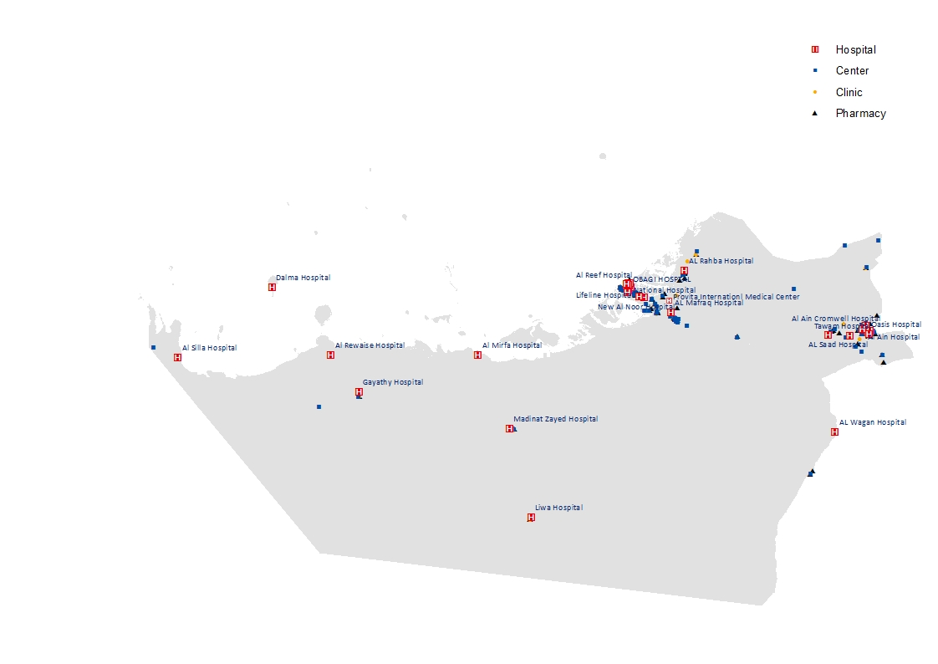
- To improve a healthcare system, you need to measure it first …
Health Reform in the Emirate of Abu Dhabi
Hospital
H
Center
Clinic
Pharmacy
… So there was a need to collect patient data from > 1,000 healthcare facilities across the Emirate of Abu Dhabi and implementing mandatory health insurance sure helped . . .
Source HAAD Licensing database, GPS survey; not all Center and Clinic locations shown
C39

Slide 5

Abu Dhabi Health Data Journey …
Data Collection
1
1
Data Clean up
2
2
Data Analytics
3
3

Slide 6

Mandatory health insurance has been accompanied by the Data Standards and e-Claims system
Payers may not receive paper
Providers must use clinical codes
All prices must be linked with standard clinical codes
www.haad.ae/datadictionary
Before 2008, Documentation was minimal and Coders were rare
Notes:
-standardised, coded data (for diagnosis, activities like labs and procedures) flowing routinely for all healthcare encounters in Abu Dhabi
-everyone is ‘speaking the same language’ - One predictor of high quality care is good, trustworthy data

Slide 7
How is DOH able to monitor the healthcare system activities day after day?
Through mandating health insurance for all Abu Dhabi residents and e-claims implementation, DOH has access to the person register and e-claims detailed Coded data in the post office (KEH)
Claim
Submission
Post Office (KEH)
Providers
Insurers
Remittance
Advice
More than 200 validation rules were implemented
Everyone uses Post Office for data exchange
All files are submitted to Post Office
Files can be submitted and received any time

Slide 8
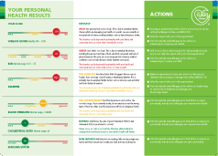
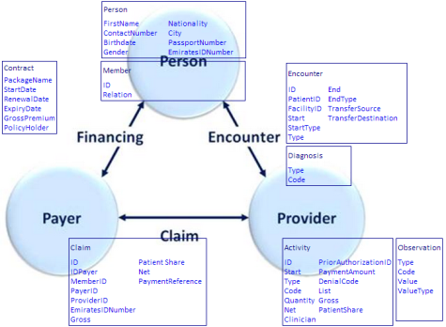
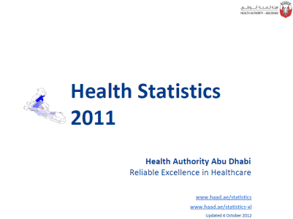
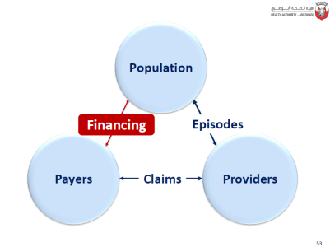
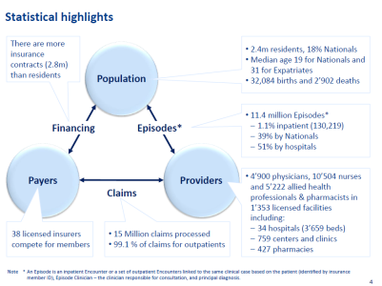
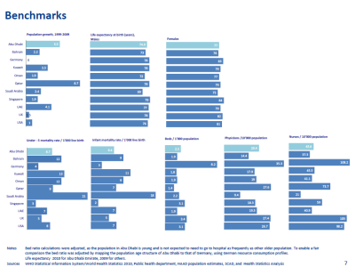
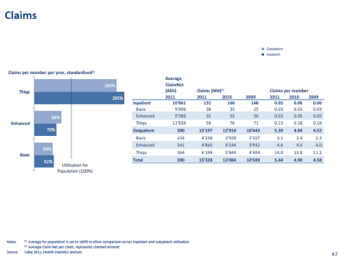
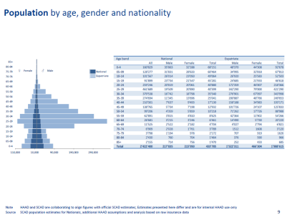
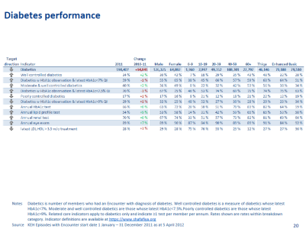
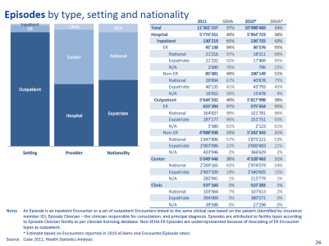
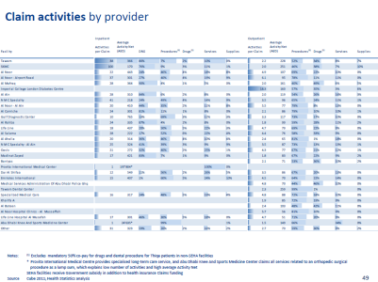
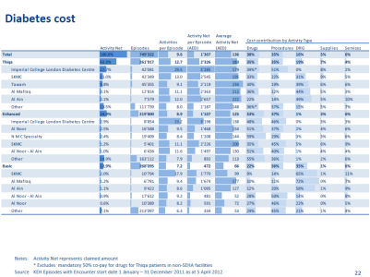
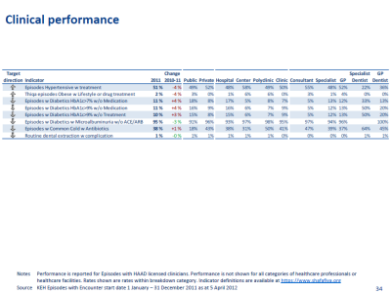
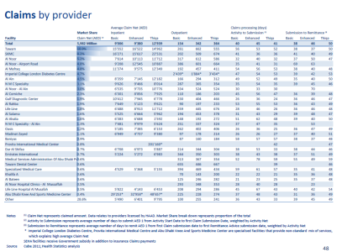
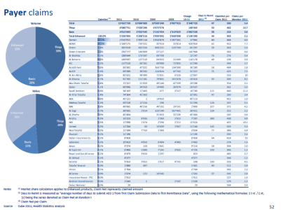
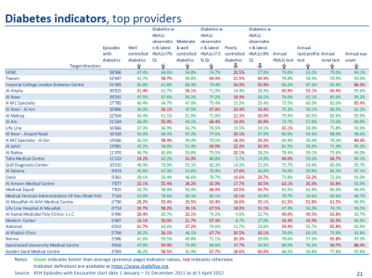
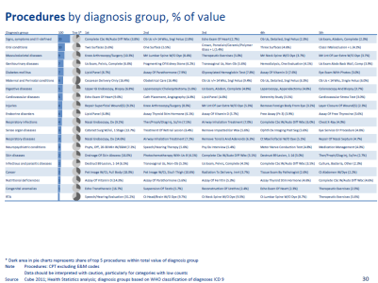
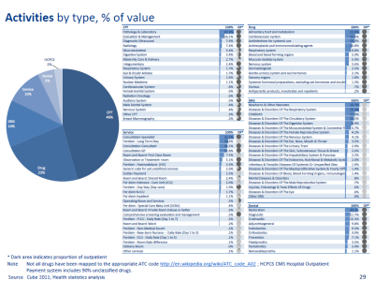
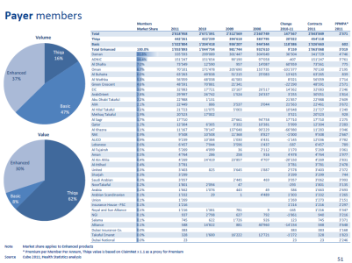
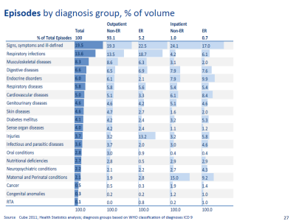
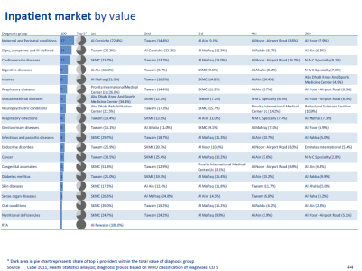
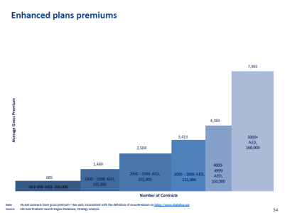
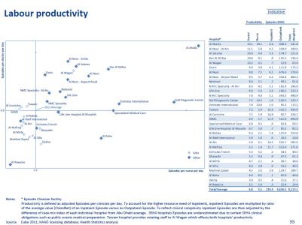

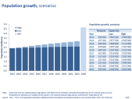
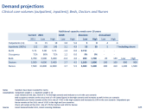
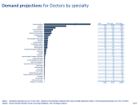
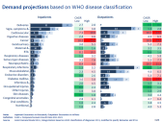
Health Information Data Collection and its Use in Evidence Based Strategic Decisions
Why healthcare information is needed for the regulator?
Providers
Knowledge Engine for Health DW
Weqaya portal
Main data tables | Records, M Jan10-Nov15
Member |  | 12.7
Episode |  | 92.7
Claim |  | 131.1
Encounter |  | 131.5
Diagnosis |  | 347.1
Activity |  | 477.2
Observation |  | 58.1
Licensing
Facilities
Payers
Professionals
Insurance products
Payers
Data architecture
Demographics
eClaims
Pharmacy Benefits Management
eAuthorisation
ePrescribing
Routine reporting:
Strategy
Strategy
Strategy
Statistics & Modelling
HF Advisory & Monitoring
Policy & Standards
Policy
Manuals
Policy impact assessment
Policy evaluation
Professional
Providers
Insurersl
Diabetes
HbA1c
Fasting plasma glucose
Plasma glucose
Fasting triglyceride
Blood cholesterol LDL
Blood cholesterol HDL
Albumin
Microalbumin
Clinical signs
Body Height
Body Weight
Intravascular systolic
Intravascular diastolic
History of tobacco use
Breast cancer
Screening Mammography
Unlisted codes
Activity cost
Cancer
Date of Initial Encounter
Date of Initial Diagnosis
Date of Initial Treatment
Primary Site
Histology
Sequence Number
Behaviour
Grade
Laterality
Basis of Diagnosis
Clinical T, N, M
Clinical Stage Group
Pathologic T, N, M
Pathologic Stage Group
Multiplicity Counter
Marital Status
Occupation
City of Residence
Weqaya
Random glucose
HbA1c
Total cholesterol
Blood cholesterol in HDL
Total vitamin D
Serum Creatinine
Body height
Body weight
Intravascular systolic
Intravascular diastolic
Circumference at umbilicus
Circumference
100-question questionnaire:
Education
Employment
Network
Family history
Smoking
Food choice
Physical activity
Regulators
Data validation for clinical quality management system
External and internal requests
Advise to other departments
Health System Strategy Review
Financing model
DRG weights update
Compliance enforcement framework
Health System Regulation
Analysis of prescribing patterns
Enforcement of compliance
Public Health
Weqaya
CVD, Asthma analyses
Key Performance Indicators
DG office
External requests
Communications
Publications of health sector data in media
Planning & Investment
Health SystemFinancing
Audit
Enforcement
Mandatory Tariff
Key Performance Indicators
Planning applications
Capacity planning
Capacity management initiative

Slide 9
Why healthcare information is needed for the regulator?
To enable the regulator to plan healthcare improvements initiatives through
Quality : Rewarding better quality providers to improve patient experience
Access: Identifying linked capacity gaps to under priced services for future enhancements
Cost: Increasing efficiency, more value for the money, and monitoring claims submission and payment to improve providers cash flows and its timeline
All the above are directly or indirectly linked to the sustainability of the health insurance system

Slide 10
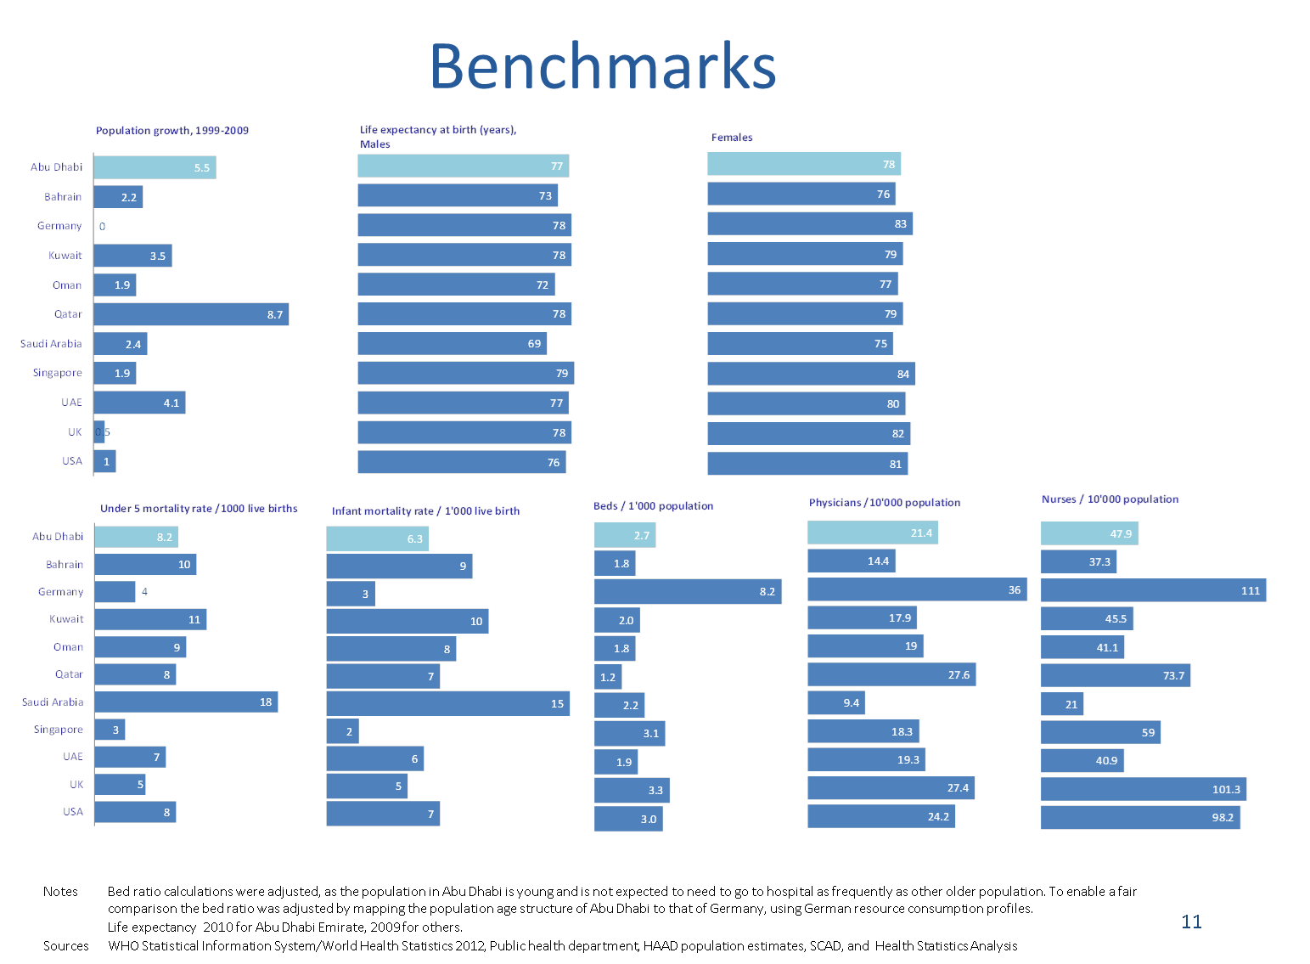
Quality
How about health care data utilization for Quality Monitoring?
In DOH, healthcare data enables to compare Abu Dhabi clinical performance with GCC and other countries, as well as comparing between one provider and another
low quality provider who tends to abuse healthcare services

Slide 11
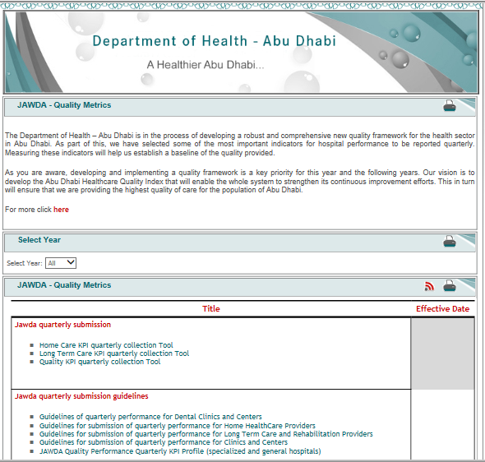
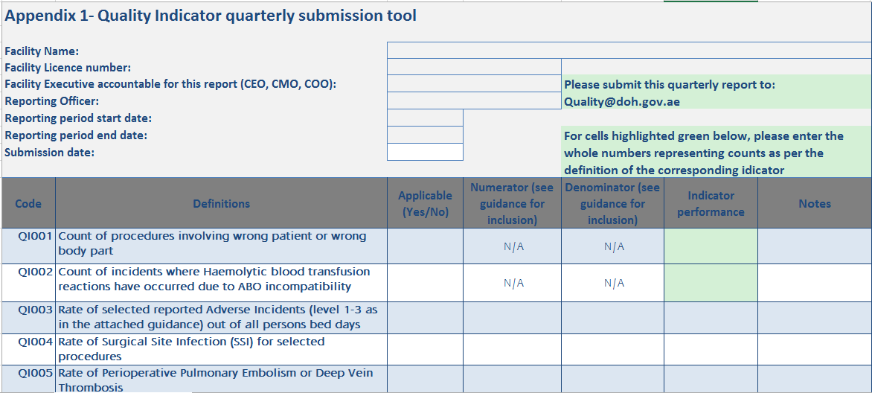
Quality
Providers Quality
In DOH, healthcare data enables us to compare Abu Dhabi clinical performance with GCC and other countries, as well as comparing between one provider and another
low quality provider who tends to abuse healthcare services, and allocate incentives and deductions accordingly (Pay for Jawda)

Slide 12
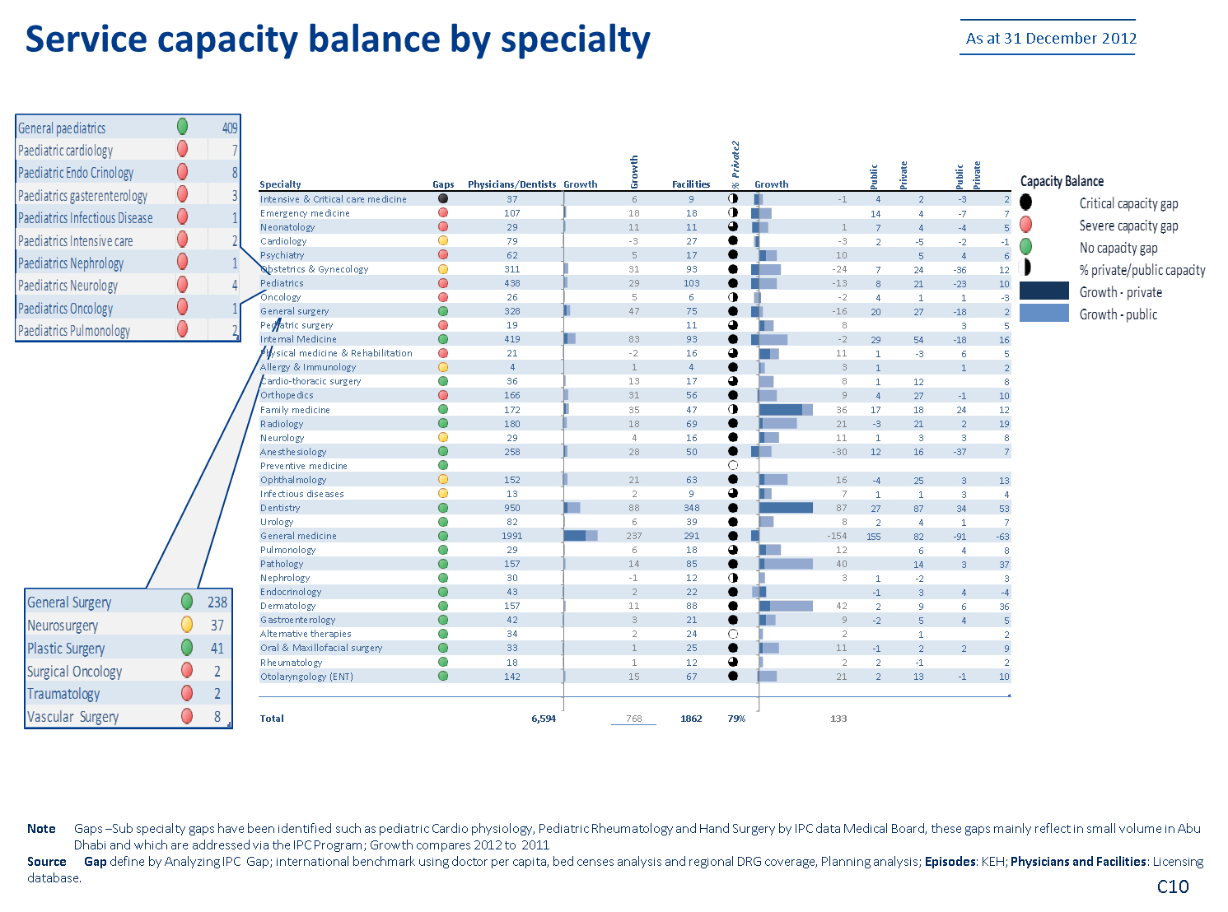
Healthcare data helps the regulator in planning health care geographic access improvements, by studying available capacity, demand, and identifying capacity gaps (and limiting Supply induced Demand to control utilization)
Access

Slide 13
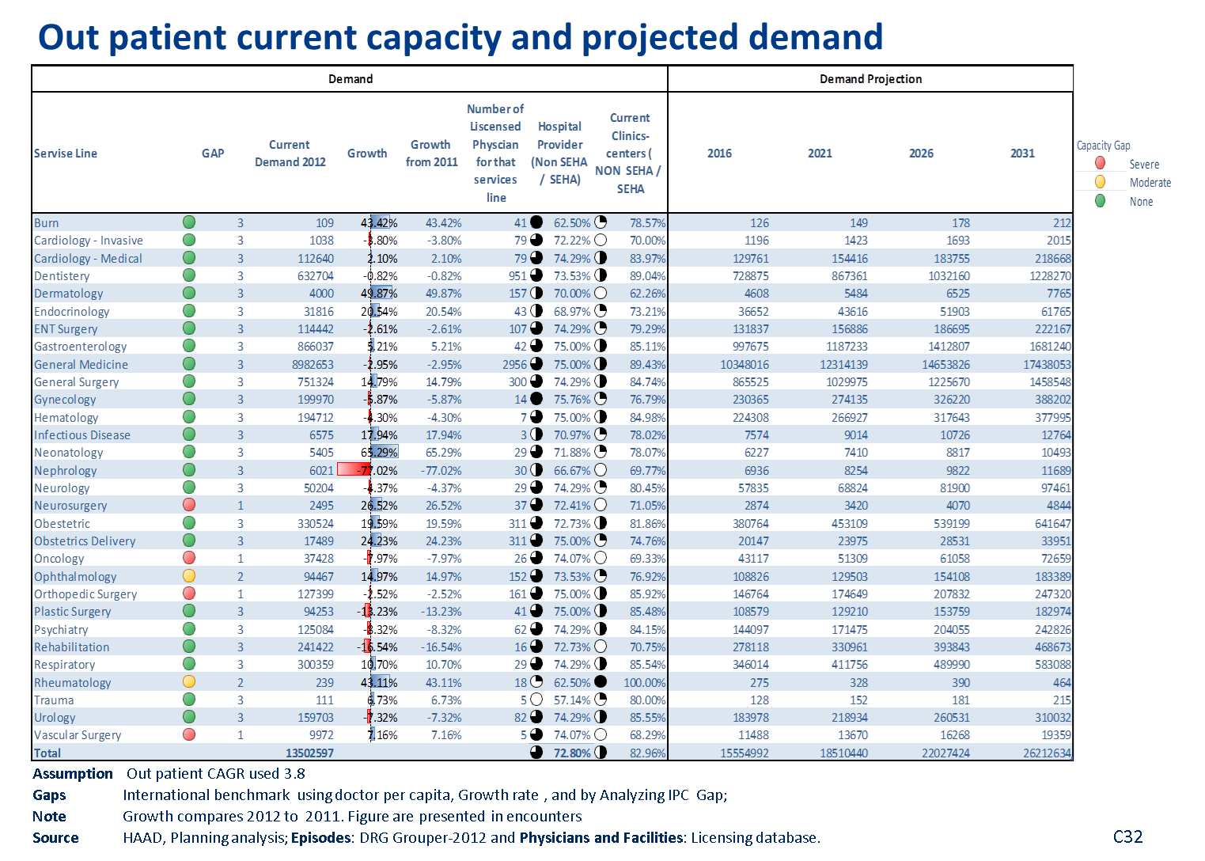
Planning health care service line access improvements, by studying current demand as well as projected demand gaps (and limiting Supply induced Demand to control utilization)
Access

Slide 14
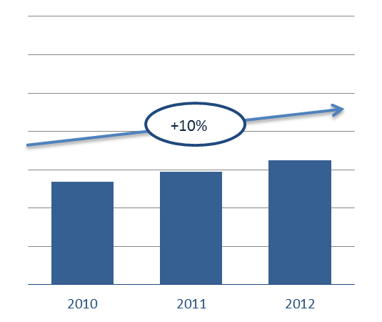
With the detailed Abu Dhabi e-claims data system DoH is able to estimate the total spend in whole Abu Dhabi or group of entities on a high level, and even better ..
Cost
1. Sources of Funds: Government, Employers, Individuals
? %
2. Providers :
Public,
Private,
Abroad
2015 2016 2017
3. Encounter Type:
Inpatient,
Outpatient,
Emergency
….. that you can break down by
4. Member group:
Basic,
Enhanced,
Thiqa
5. Diagnosis Group:
Respiratory,
Circulatory,
Digestive, …
6. Increase reason :
Population Increase,
Utilization change,
Price Inflation

Slide 15
Activities by type, % of value
Analyzing KEH data provides valuable financial health stats as published on ww.haad.ae
* Dark area indicates proportion of outpatient
Note Not all drugs have been mapped to the appropriate ATC code http://en.wikipedia.org/wiki/ATC_code_A02 ; HCPCS CMS Hospital Outpatient Payment system includes 90% unclassified drugs
Source Cube 2012; Health statistics analysis

Slide 16
DOH’s innovation strategy in data analytics continues to address healthcare sustainability key chllenges: Quality, Access, and Cost
Principal challenge
Regulatory action
Implementation
Inpatient
~1/4
Case inflation
No transparency
DRG implementation
DRG Add on payment
Consultation & Homecare
~1/5
Pay for qualification not service and case severity
Evaluation&Manag. E&M Circulars
Bundled Homecare
Drugs
~1/5
Volume growth
Mix Brand-Generic
PBM Standard
Ancillary
~1/4
Volume growth
Often “profit center”
price adjustment
Lab license requirements

Slide 17
When it comes to Digital Technologies, it is cost effective not to reinvent the wheel, however you need to..
01
Understand your needs
02
Choose the most fit technology
01
02
03
Customize it effectively
03

Slide 18
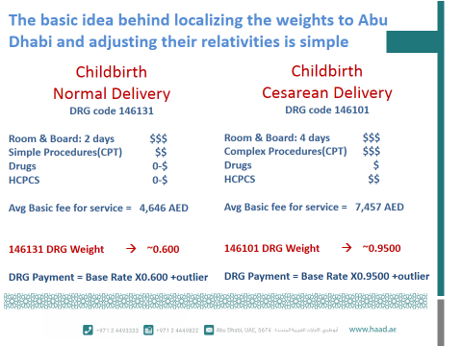
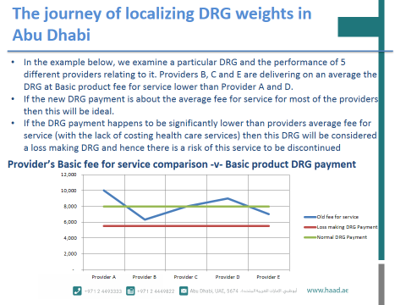
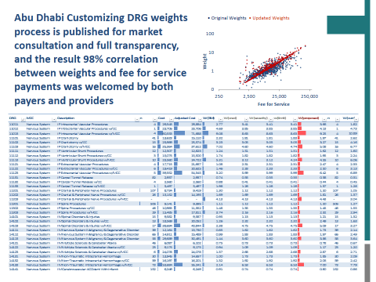
The successful journey of localizing DRG weights in Abu Dhabi wouldn’t happen without local innovative data analytics
it proved its effectiveness in controlling inpatient spend inflation

Slide 19
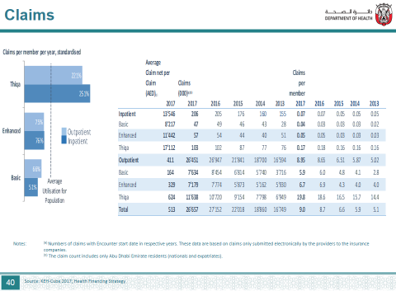
Published stats show DRG inpatient claims utilization is more controlled with lower rejection% compared to outpatient
Fee for service
Draft

Slide 20
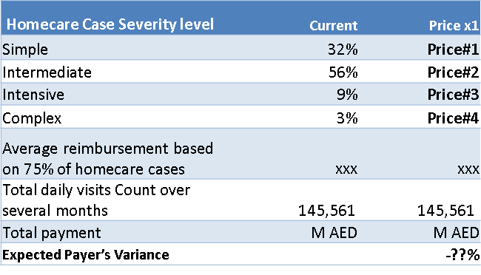
Data Analytics was also essential in developing bundled Homecare services which dropped its spend and ensured its financial sustainability
which controlled the growing spend on the original homecare fee for service activities
Original Homecare reimbursement
Bundled Homecare reimbursement
CPT(procedures)
+
HCPCS (for mileage)

Slide 21
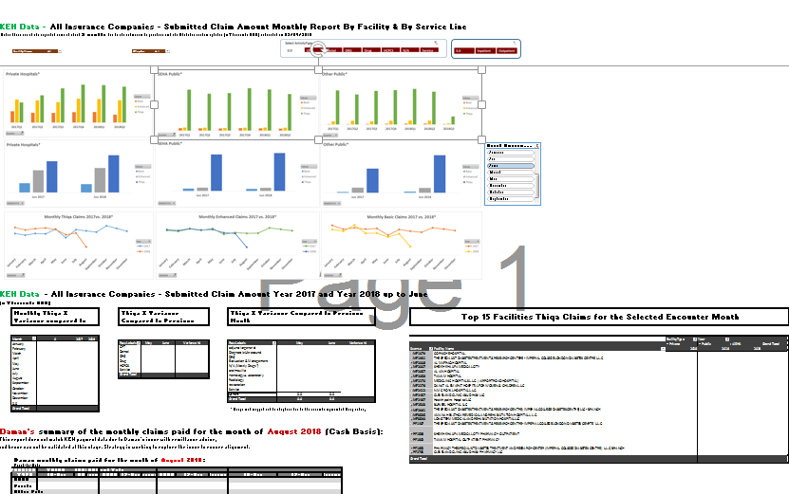
Data Analytics was also used in monitoring utilization and financial sustainability through innovative locally developed dashboards
Hospital Matrix Dashboard
Dental utilization Dashboard
Monthly Claims Dashboard
Sick leaves Dashboard
Audit Tool

Slide 22
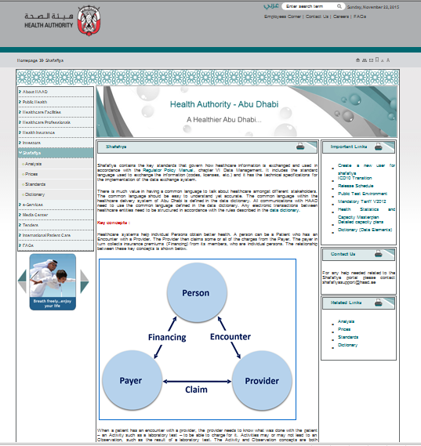
Data Analytics was also used by DOH to develop useful reports and tools for the market to use for their operations
Health Authority of Abu Dhabi main website: www.haad.ae/ → Shafafiya
‏

Slide 23
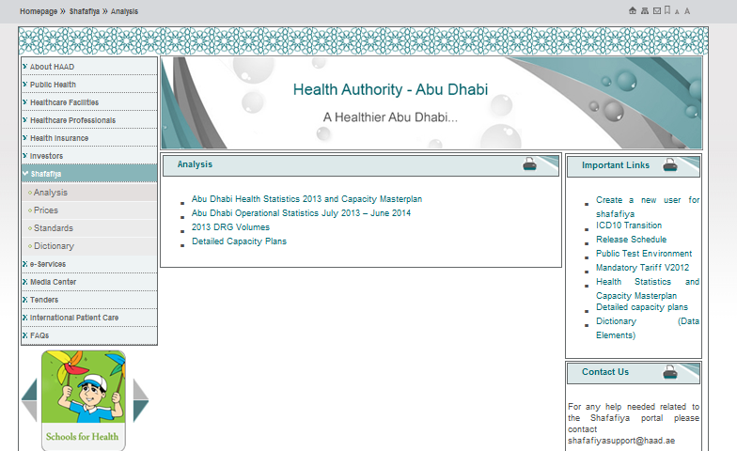
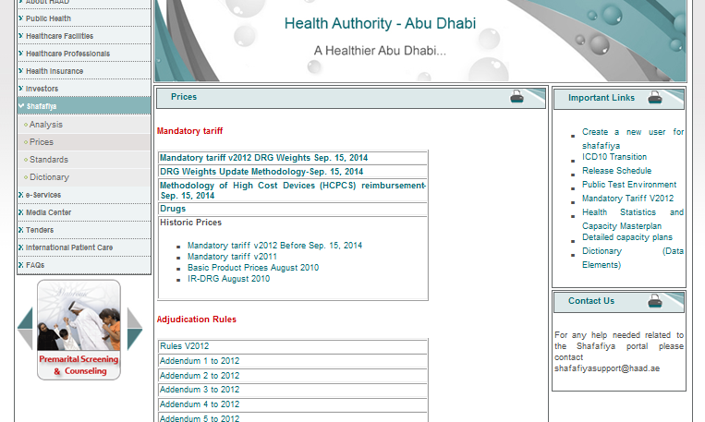
Useful Resources and Tools for Healthcare Investors:
Health Authority of Abu Dhabi main website: www.haad.ae/ → Shafafiya
→Analysis →Prices

Slide 24
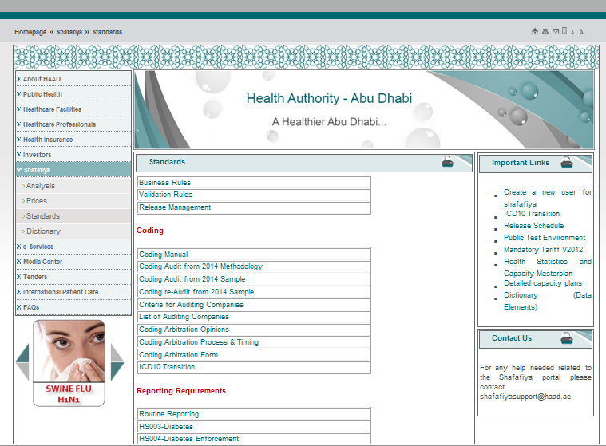
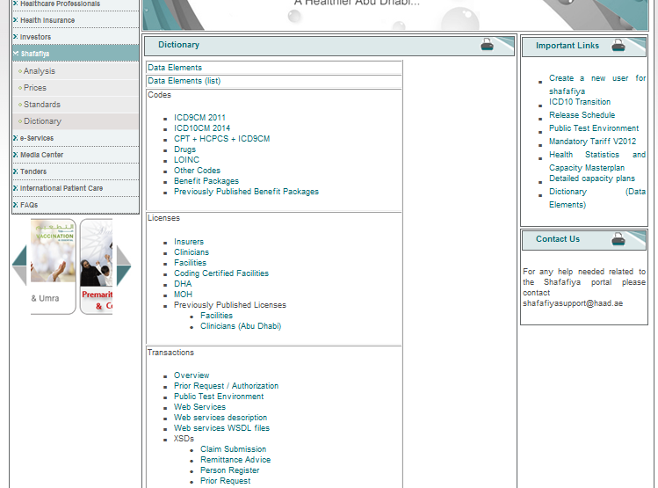
Useful Resources and Tools for Healthcare Investors:
Health Authority of Abu Dhabi main website: www.haad.ae/ → Shafafiya
→Standards →Dictionary

Slide 25
In Summary..
Does Department of Health use Data analytics effectively to control cost and publish some of the reports for payers and providers to use?
✓
✓
Can payers do more with healthcare analytics to control their cost?
Can providers do more with healthcare analytics to sustain their business?
✓

Slide 26
Can payers do more with healthcare analytics to control their cost? This will sure help them distinguish facts from myths and adjust their operations accordingly
Low Provider prices (multiplier) →low annual claim cost
✗
Facilities with more GPs have lower claims cost
?
Identifying fraud and abuse is cost effective
✓
Premiums should rely on just age and gender
✗

Slide 27
Where to start? If you have not done so already, we recommend having a detailed dashboard by count and dirham amount of the most granular level of data points available and identifying trends and projections:
Product#
Main Policyholder
Facility
Service line
Inpatient
Outpatient
Service type
Quality & Financial KPIs

Slide 28
Questions?

